Slide 1
Foreign Direct Investment Analytics

Slide 2
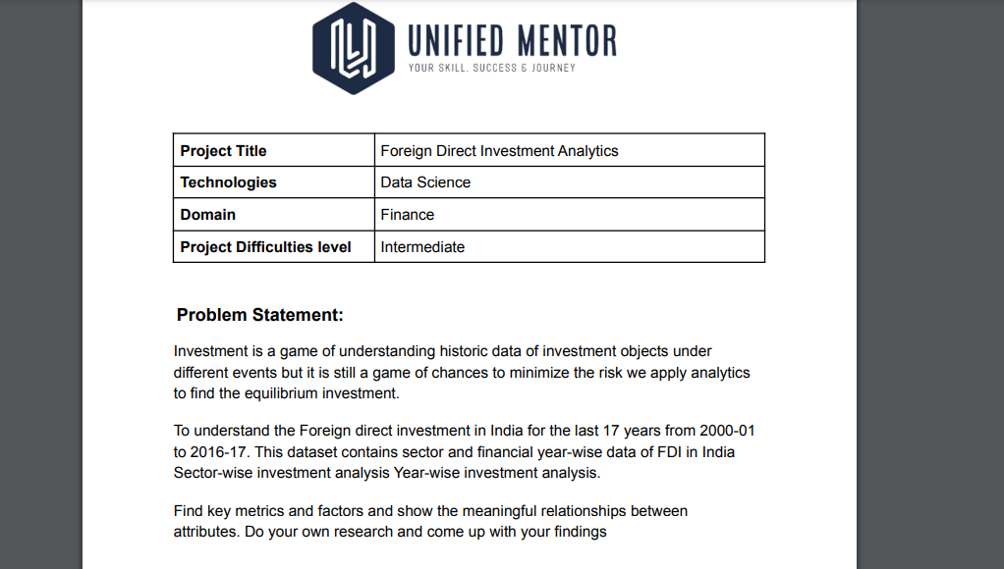

Slide 3
Project Background-
Investment is a game of understanding historic data of investment objects under different events but it is still a game of chances to minimize the risk we apply analytics to find the equilibrium investment. To understand the Foreign direct investment in India for the last 17 years from 2000-01 to 2016-17. This dataset contains sector and financial year-wise data of FDI in India Sector-wise investment analysis Year-wise investment analysis. Find key metrics and factors and show the meaningful relationships between attributes. Do your own research and come up with your findings

Slide 4
Project Evaluation metrics:
● We are supposed to write code in a modular fashion
● Safe: It can be used without causing harm.
● Testable: It can be tested at the code level.
● Maintainable: It can be maintained, even as your codebase grows.
● Portable: It works the same in every environment (operating system)

Slide 5
Pseudo Code Implementation and Algorithm Followed-
Extract the data from csv files using Pandas.
Add respective columns to dataframe
Create function to exchange the currency based on rates
Use pandas melt function get records
Merge and aggregate data according to requirements
Plot graph to visualize the results
Highlight the data insights using pandas functions

Slide 6
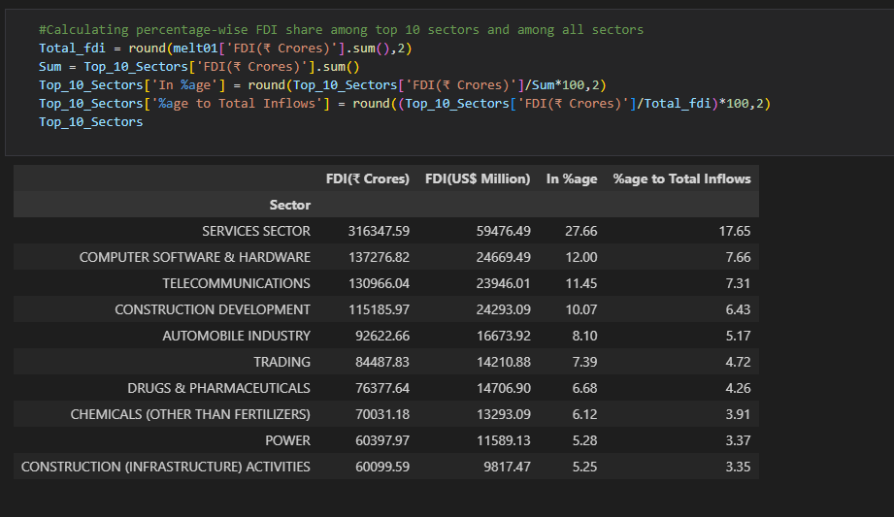
Code Overview and Results-

Slide 7
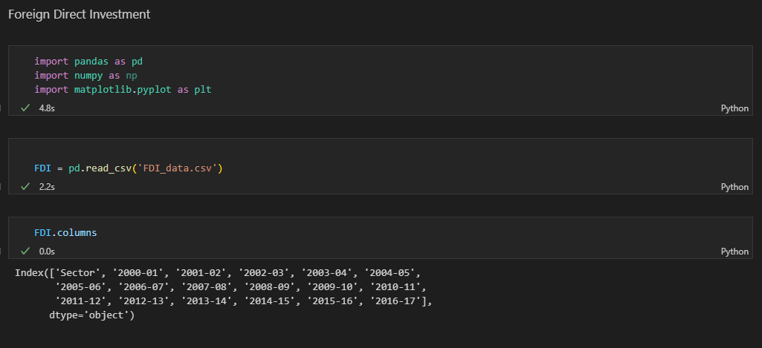
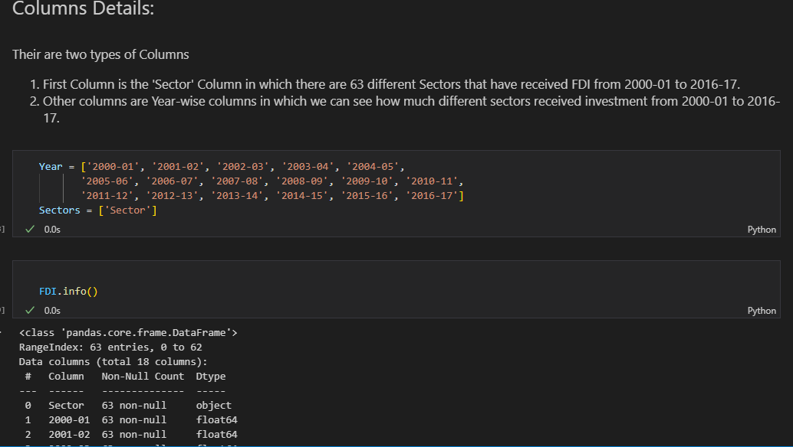

Slide 8
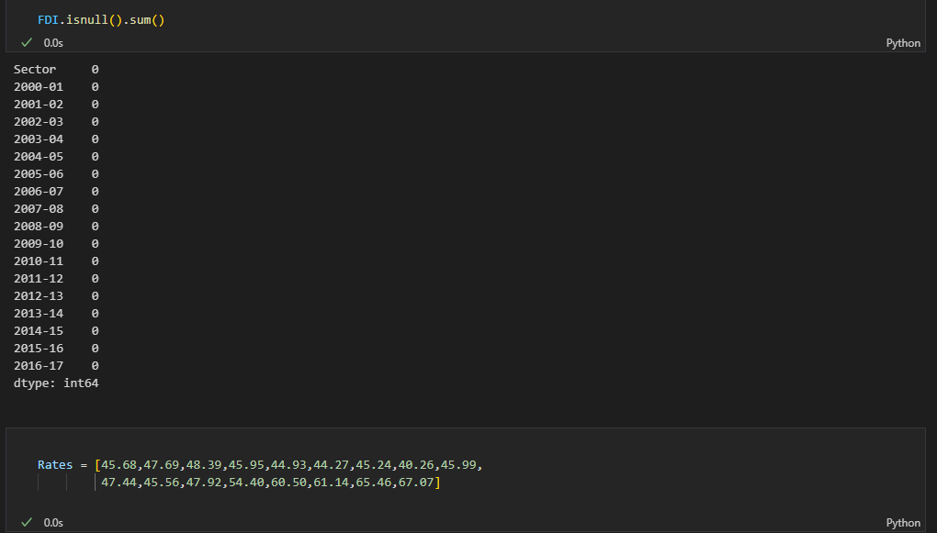
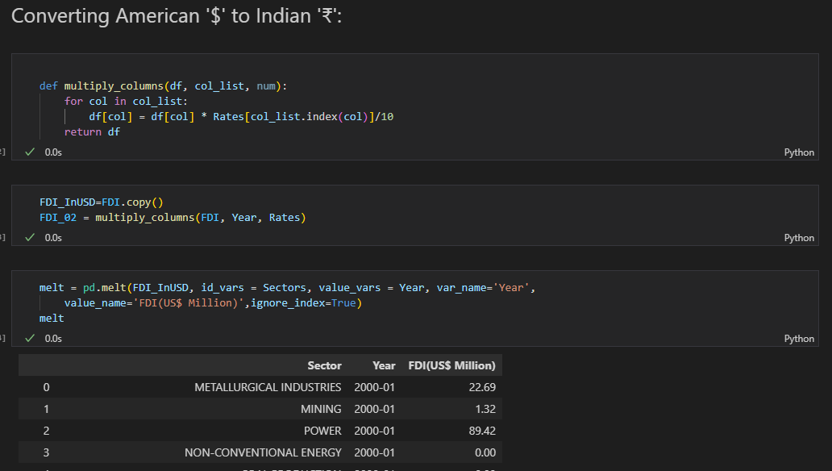

Slide 9
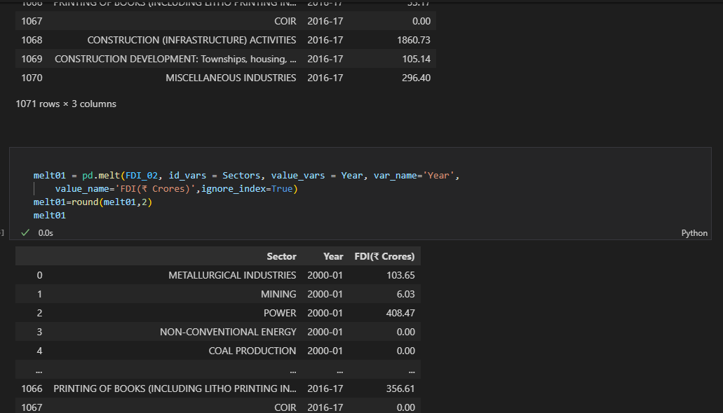
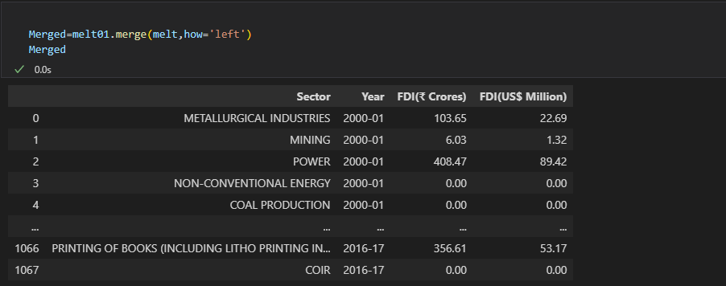

Slide 10
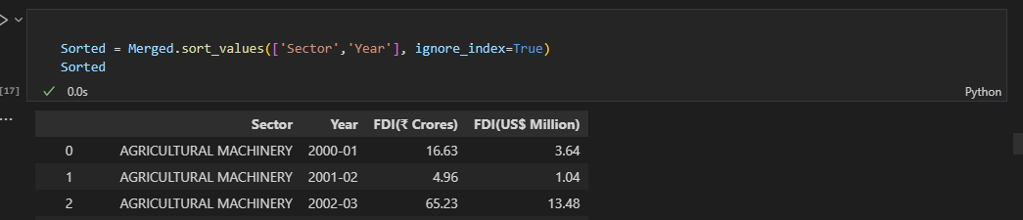
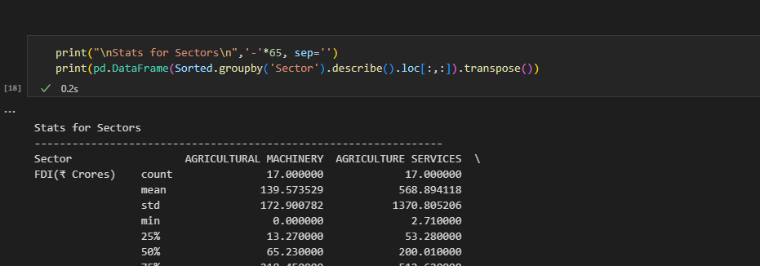
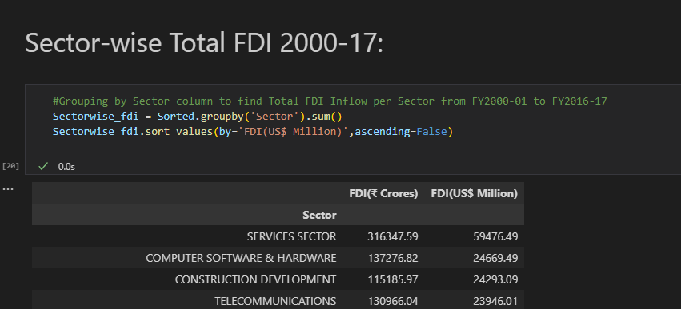

Slide 11
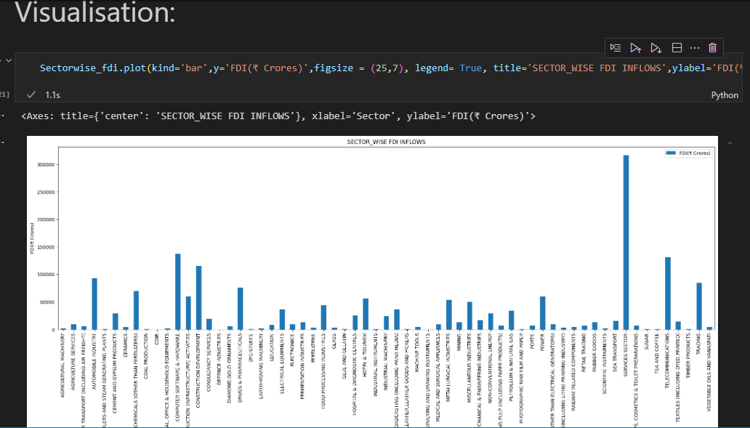

Slide 12
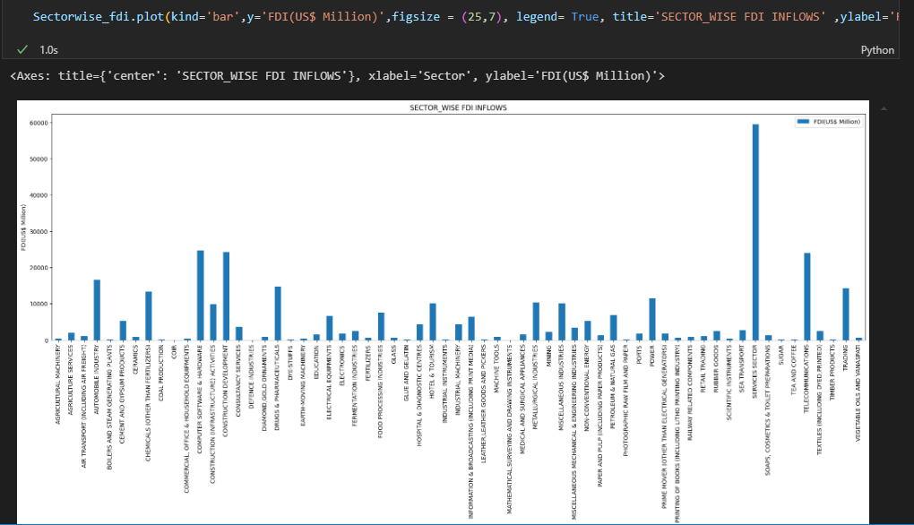

Slide 13
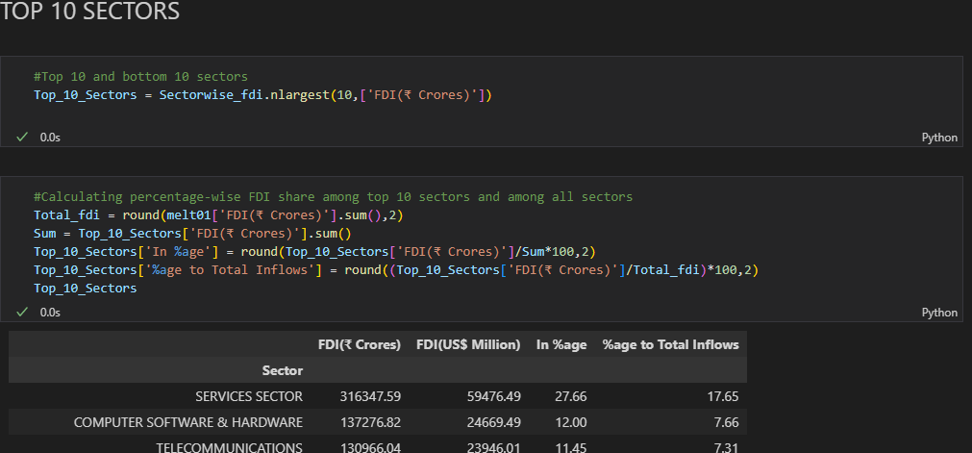
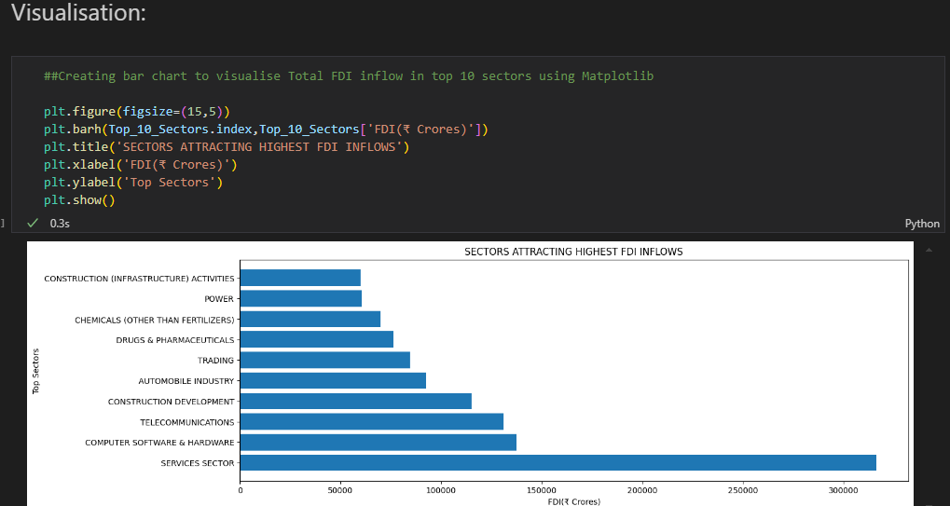

Slide 14
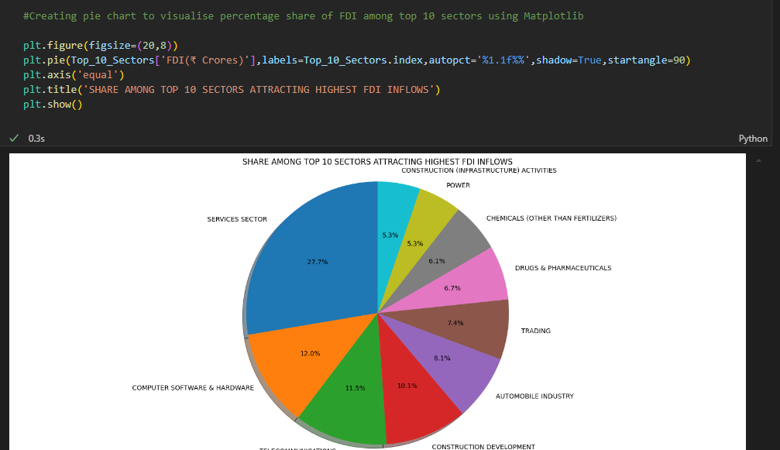
From the above Chart, we can understand that Service Sector Managed to Attract highest FDI which was ₹316347.59Cr greater than any other Sector and among top 10 Sectors it has 27.7% share and among all it has 17.65%.

Slide 15
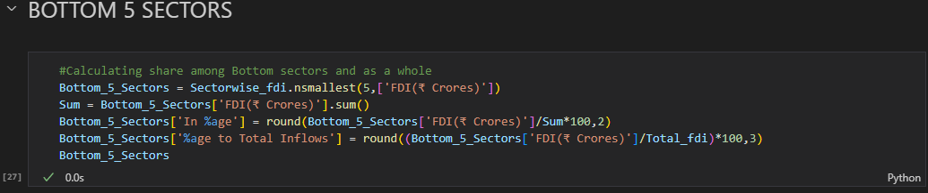
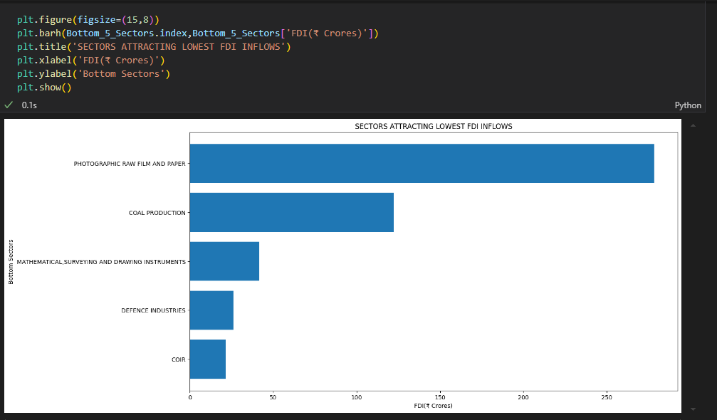

Slide 16
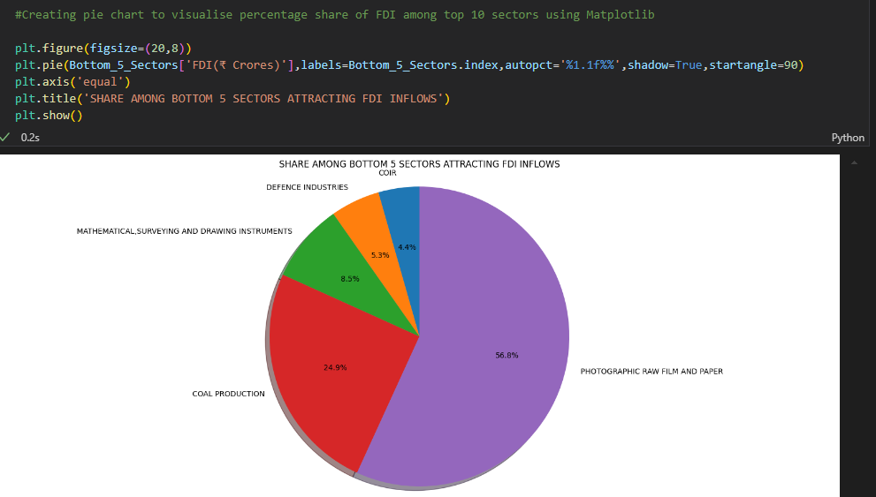

Slide 17
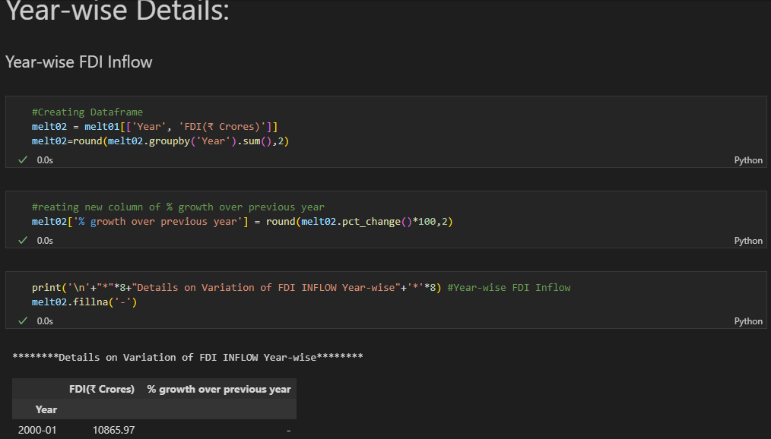

Slide 18
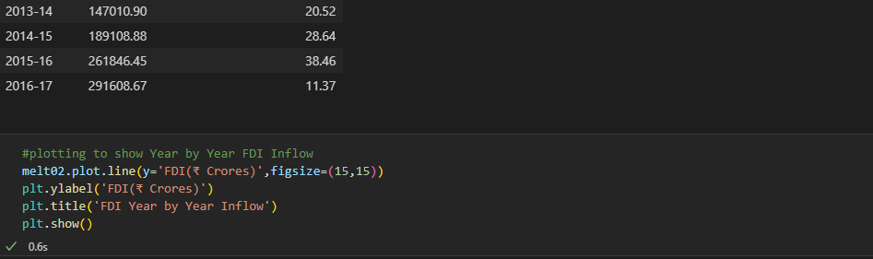
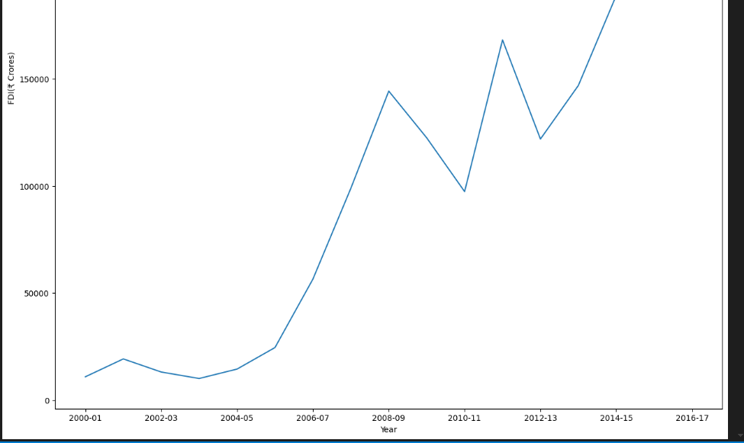

Slide 19
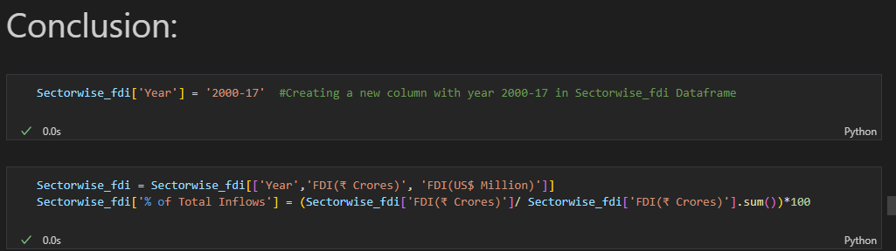
The previous graph shows the total amount of FDI inflows in India during the last 17 years i.e. 2000 to 2017. The FDI inflow from 2000-2001 i.e. ₹10865.97Cr. in 2001-02 it was ₹19208.02Cr. It shows the Good result in the FDI inflows in India. Little bit ups and downs in FDI inflows up to 2005-06, but after that great hike in the year 2007-08 and FDI was ₹98940.57Cr. In 2008-2009 there was a huge investment in FDI in ₹144390.03Cr.
THANKYOU

